Slide 1

Snow melting and stream temperature trend analysis within Yosemite National park area
Ximin Hu & Lightman He

Slide 2
Introduction
Yosemite graph
Site explanation
Background explanation-water temp and snow melt and air temp

Slide 3
Physical process graph

Slide 4
Questions to answer
Core question: Did the snow melting affect the stream?
Stream behavior during different periods
Relationship between air temp and discharge increase
Relationship between air temp and water temp
Did site size/location matters

Slide 5
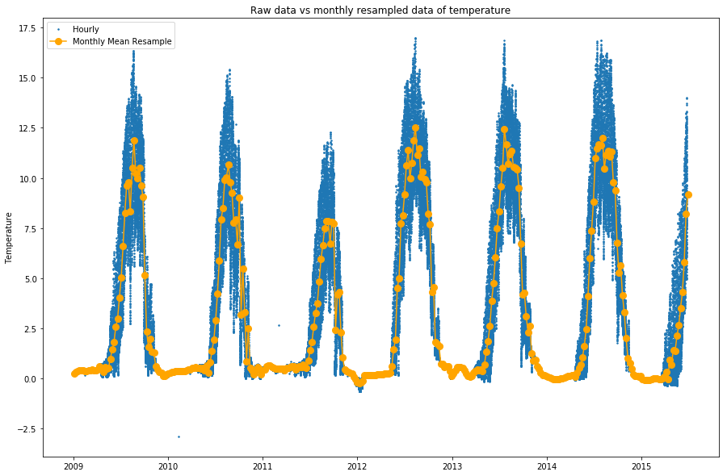
Statistical analysis
Pretreat the dataset

Slide 6
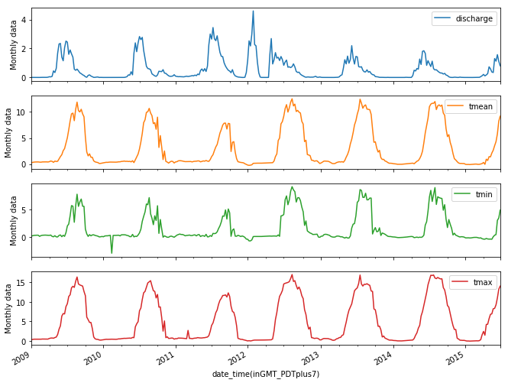
Statistical Analysis
Check trends for all major variables

Slide 7
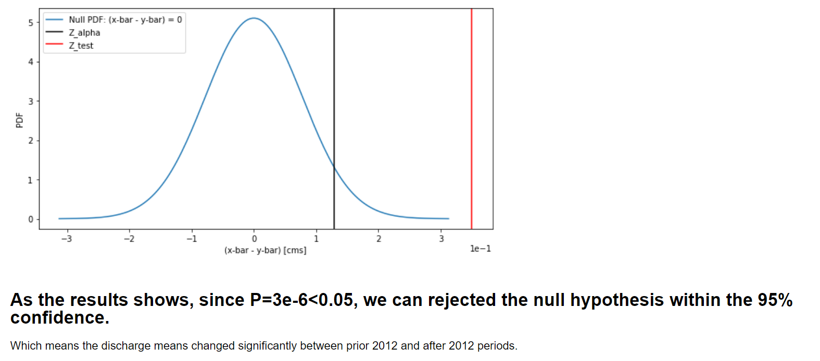
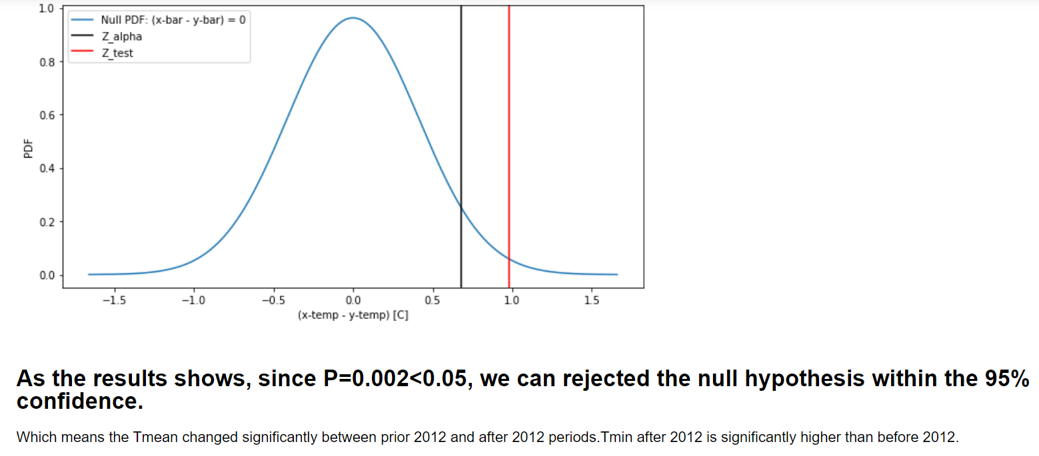
Statistical analysis
Did the water temperature and discharge significantly change around 2012?

Slide 8
Relationship between air temperature and stream rise
In current study we regarded 20% of total discharge as the ‘rising point’
Match the rising point date with the temperature trend to see if there is any relationship

Slide 9
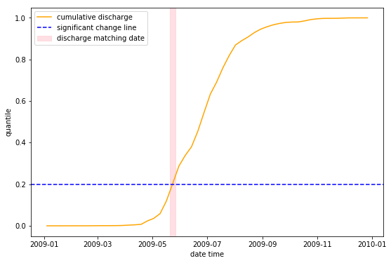
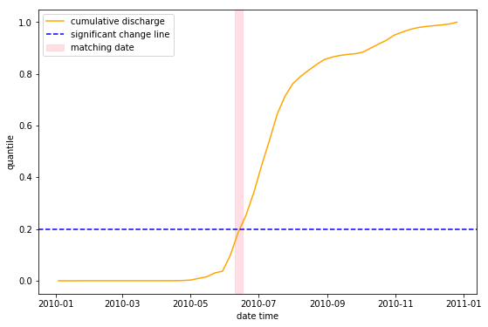
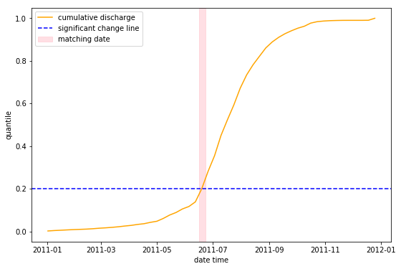
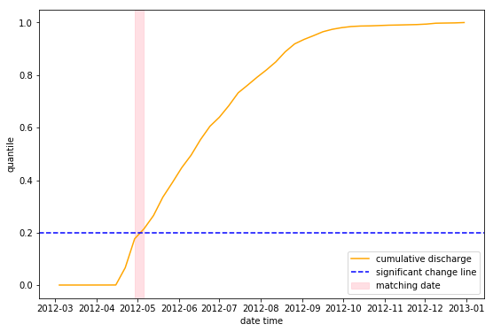
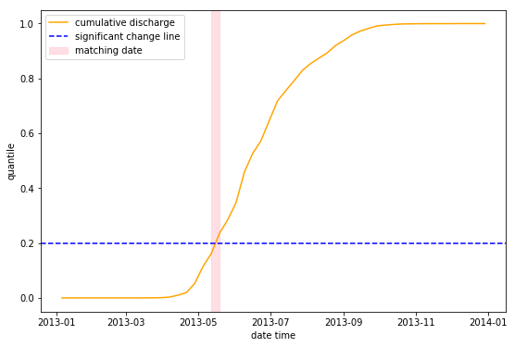
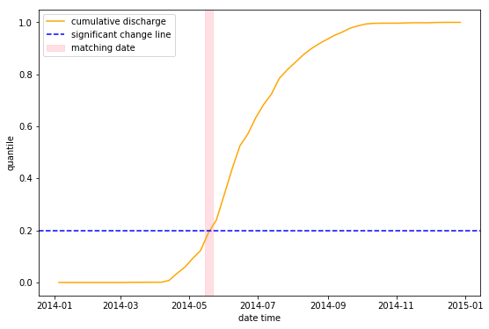

Slide 10
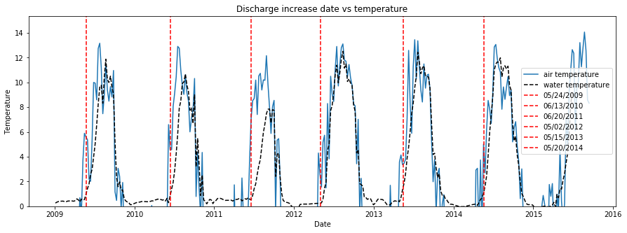
Discharge summary
2009: 5/24
2010: 6/13
2011: 6/20
2012: 5/2
2013: 5/15
2014: 5/20
Here we can propose that the temperature after 2012 is slightly higher than before 2012.

